Slide 1
CS5412: SPRING 2014
CLOUD COMPUTING
CS5412 Spring 2015 (Cloud Computing: Birman)
Ken Birman
Lecture 1

Slide 2

Welcome to CS 5412...
A course dedicated to the technology behind cloud computing!
In my country of Khazackstan, many excellent hacker. We hack cloud, steal private stuff of whole world!
CS5412 Spring 2015 (Cloud Computing: Birman)

Slide 3
Cloud Computing: The Next New Thing
A general term for the style of computing that supports web services, search, social networking
Increasingly powerful and universal
Enables a new kind of massively scaled, elastic app
Our goal: understand the technology of the cloud, its limitations, and how to push beyond them
Invent “highly assured cloud computing” options
CS5412 Spring 2015 (Cloud Computing: Birman)

Slide 4









Today’s Cloud: Surprisingly limited
Big data, updates by “owner”
Dominated by reads
Index... search... share
Monetized by advertising, sales
CS5412 Spring 2015 (Cloud Computing: Birman)

Slide 5












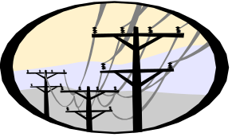
Tomorrow’s cloud?
Big data, updates by “owner”
Dominated by reads
Index... search... share
Monetized by advertising, sales
eHealth
High assurance
Real-time control
Runs “everything”
Monitized by “roles”
eChauffer
CloudBank
GridCloud
CS5412 Spring 2015 (Cloud Computing: Birman)

Slide 6
Clouds are hosted by data centers
Huge data centers, far larger than past systems
Very automated: far from where developers work. Often close to where power is generated
(ship bits... not watts)
Packed for high efficiency. Each machine hosts many applications (usually in lightweight virtual machines to provide isolation)
Scheduled to keep everything busy (but overloads hurt performance so we avoid them)
CS5412 Spring 2015 (Cloud Computing: Birman)

Slide 7
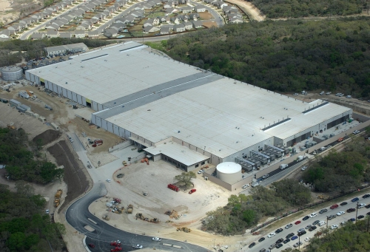

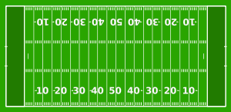
Clouds are cheaper… and winning…
Range in size from “edge” facilities to megascale.
Incredible economies of scale
  Approximate costs for a small size center (1K servers) and a larger, 50K server center.
Technology | Cost in small-sized Data Center | Cost in Large Data Center | Cloud Advantage
Network | $95 per Mbps/ month | $13 per Mbps/ month | 7.1
Storage | $2.20 per GB/ month | $0.40 per GB/ month | 5.7
Administration | ~140 servers/ Administrator | >1000 Servers/ Administrator | 7.1
Each data center is
11.5 times
the size of a football field
Slide provided by Roger Barga, Head of Cloud Computing, Microsoft

Slide 8
Key benefits?
Machines busier, earn more $’s for each $ investment
  Hardware handled a whole truckload at a time
Applications far more standardized
  Automated management: few “sys admins” needed
  Power consumed near generator: less wastage
  Data center runs hot, wasting less on cooling
  Can “rent” resources rather than owning them
Supports new, extremely large-scale services
  Elasticity to accomodate surging demands
  Can accumulate and access massive amounts of data
    But must read or process it in a massively parallel way
  Enables overnight emergence of major companies, but scalability model does require new programming styles, and imposes new limits
CS5412 Spring 2015 (Cloud Computing: Birman)

Slide 9
Assurance properties
Unfortunately, today’s cloud
  Has a limited security model focused on credit card transactions
  Weakens consistency to achieve faster response times: the cloud is “inconsistent by design”
  Pushes many aspects of failure handling to clients
Model supported by the “CAP” and “FLP” theorems, which are cited by many application designers
Instead, cloud favors “BASE”
CS5412 Spring 2015 (Cloud Computing: Birman)

Slide 10
Acronyms
CAP: A theorem that says one can have just two from {Consistency, Availability, Partition Tolerance}
FLP: A theorem that says it is impossible to guarantee “live” fault-tolerance in asynchronous systems (here, “live” ≡ certain to make progress)
BASE: A cloud computing methodology that seeks “Basically available soft-state services with eventual consistency” and is popular in the outer layers (first tier) of the cloud. The opposite of ACID
ACID: A database methodology: offers guaranted {Atomicity, Consistency, Isolation and Durability}.
CS5412 Spring 2015 (Cloud Computing: Birman)

Slide 11
CS5412: How to do better!
Future cloud will need stronger guarantees than we see with today’s cloud
  How can we achieve those?
  Are strong guarantees “scalable”?
Betting that the cloud will win
  Cheaper than other options...
  ... and the cheaper option usually wins!
  But technology also advances over time, which helps!
CS5412 Spring 2015 (Cloud Computing: Birman)

Slide 12
Making the cloud highly assured
Find ways to overcome limitations like FLP and CAP
Define new assurance goals that might still be forms of security and consistency but are easier to achieve
Only consider things that are real enough to be implemented and demonstrated to scale well and perform in a way that would compete with today’s cloud platforms. A practical mindset.
But use theoretical tools when theory helps with goals.
CS5412 Spring 2015 (Cloud Computing: Birman)

Slide 13
… And making it fast
The cloud makes it easy to create “mashups”
  Applications send data to each other, one system might “call upon” 10 or 100 others for help
  Very powerful but also very inefficient in some ways
    Example: Networks that become overloaded because of the same image or video being sent again and again!
Getting the cloud to “scale” and perform well comes down to enabling productivity while also finding tricks to ensure super good performance
    Example”: store the image, ship a URL…
CS5412 Spring 2015 (Cloud Computing: Birman)

Slide 14


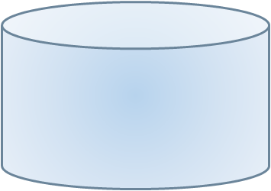





CS5412: Topics Covered
We’ll treat the cloud as having three main parts
  The client side: Everything on your device
  The Internet, as used by the cloud
  Data centers, which themselves have a “tiered” structure
    Like a dedicated and
    personal computer
    Yet massively scaled
    with many moving parts
Special theme:
high assurance

Slide 15
The Old World and the New
Old world: we replicated servers for speed and availability, but maintained consistency
New world: scalability matters most of all
  Focus is on extremely rapid response times
  Amazon estimates that each millisecond of delay has a measurable impact on sales!
But our premise is that we can have scalability and also have other guarantees that today’s cloud lacks
CS5412 Spring 2015 (Cloud Computing: Birman)

Slide 16
High Assurance: Many (conflicting) goals
Security: Only correctly authorized users (who are properly authenticated) can perform actions
Scalability: Can support lots of simultaneous users
Privacy: Data doesn’t leak to intruders
Rapid response despite failures or disruption
Consistency and coordinated behavior
Ability to overcome attacks or mishaps
Guarantee that center operates at a high level of efficiency and in a highly automated manner
Archival protection of important data
CS5412 Spring 2015 (Cloud Computing: Birman)

Slide 17
Must ask many questions
If we were to run high assurance solutions on today’s cloud, what parts of the standards would limit or harm our assurance properties?
Goal is to leverage the cloud or even run on standard clouds, yet to improve on normal options
This forces us to look hard at how things work
CS5412 Spring 2015 (Cloud Computing: Birman)

Slide 18
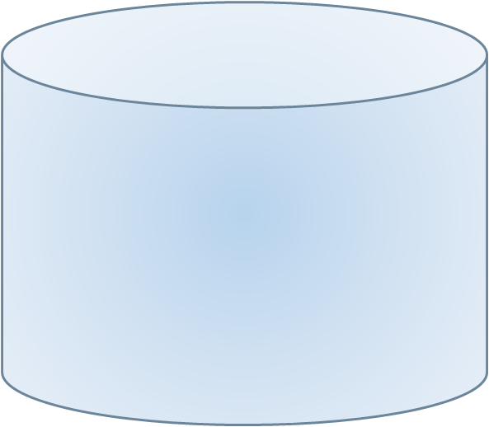
Today’s cloud focuses on easy stories
Which is better:
  Multithreaded servers?

Slide 19

Today’s cloud focuses on easy stories
Which is better:
  Multithreaded servers?
  Or multiple single-threaded servers?

Slide 20
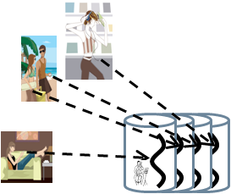
Which scales best?
Build it the easy way!
  One VM per server
  Server handles one user
  Make the server single threaded if possible
Why?
  Better fit to the hardware (no lock/memory contention)
  Quicker way to build it, reuses existing stuff
CS5412 Spring 2015 (Cloud Computing: Birman)

Slide 21
Some of today’s rules of thumb
Built from things that already exist and already work, as much as possible
Expect that each 10x scaleup will still break things and that much of your work will be on fixing them
When feasible, go for “no brainer” scalability
  Armies of cheap machines and cheap storage
  A form of “brute force” solution
Success stories of today’s cloud often are applications that naturally fit this approach
CS5412 Spring 2015 (Cloud Computing: Birman)

Slide 22
Acronyms! (How to be a party bore)
One issue with the cloud is that it has a million acronyms: IaaS, SaaS, PaaS, SOAP, AWS, EC2, S3...
  These make for a very confusing landscape!
  But a business perspective on the cloud only needs to focus on a few of them, as a starting point
What does the “aaS” mean?
  Cloud vendors sell “services”
  “aaS” == “as a Service”
CS5412 Spring 2015 (Cloud Computing: Birman)

Slide 23
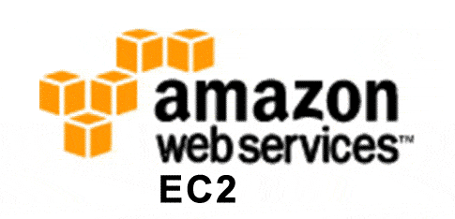
The Important *aaS options
Infrastructure. (IaaS: Infrastructure as a Service)
  Cloud vendor rents you some hardware
    A network, perhaps a wide-area network
    A machine, always “virtual” but perhaps just for you
    A file server, again virtual, but you can save files in it
  They operate this for you, and you pay for what you think you need (or sometimes, for what you use)
  And they sell backup services too
For example, you could rent a private Internet from AT&T, or 500 computers from Amazon EC2
  AWS is elastic: you rent and pay by the hour
  AWS can accommodate huge swings in your needs
CS5412 Spring 2015 (Cloud Computing: Birman)

Slide 24
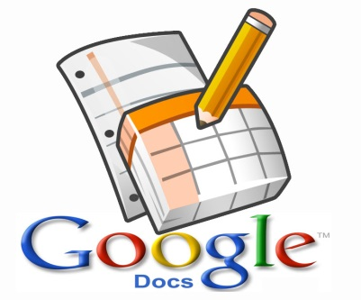
The Important *aaS options
Software. (SaaS: Software as a Service)
  Cloud vendor runs some software that you use remotely
  Classic example: SalesForce.com has a sophisticated infrastructure that manages your sales contact data
In effect you “outsource” your sales support system and SalesForce.com runs it for you
  Other SaaS options: accounting, billing, email, document handling, shared files…
  They also apply patches, fix bugs…
CS5412 Spring 2015 (Cloud Computing: Birman)

Slide 25

The Important *aaS options
Platform. (PaaS: Platform as a Service)
  Cloud vendor creates a sophisticated platform (typically a software environment for some style of computing, or for database applications)
  Your folks use it to create a custom solution
  Cloud vendor runs your solution in an elastic way
They promise that if you use their PaaS solution, you’ll benefit from better scalability, performance, ease of development or other advantages
CS5412 Spring 2015 (Cloud Computing: Birman)

Slide 26
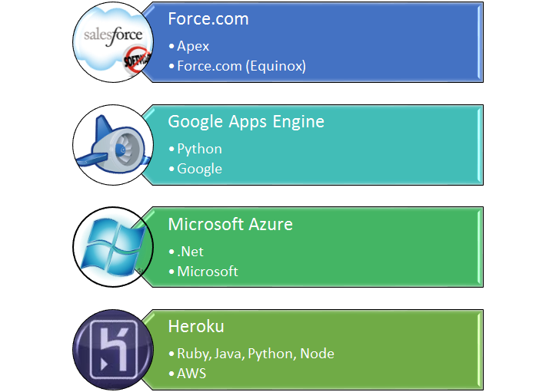
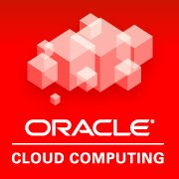
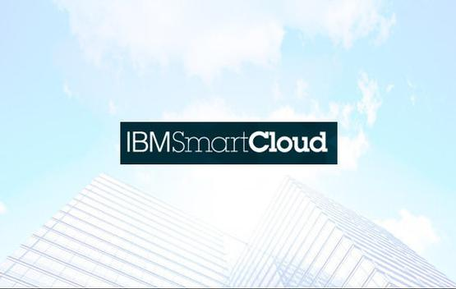
The Important *aaS options
Platform. (PaaS: Platform as a Service)
CS5412 Spring 2015 (Cloud Computing: Birman)

Slide 27
… these aren’t the whole cloud
The cloud mixes many models
  Some integrate humans into the loop, such as outsourced audio-to-text, or Amazon’s Mechanical Turk
  There are companies with specialized roles
    Akamai: The most famous data hosting company, especially successful for storing videos and images that are used in your web pages. They specialize in rapid data delivery
    DoubleClick: You leave a frame on your web page, they put the perfect advertisement for this particular user in it
  There are even cloud “HPC systems”! (Rent on demand)
CS5412 Spring 2015 (Cloud Computing: Birman)

Slide 28
But some standards pervade…
The cloud really took off as an outgrowth from web sites and browsers
  First we had browsers, HTML (a use of XML), HTTP, SSL
  Then people had the idea of doing “client server” computing using browser web pages!
    Called SOAP. A program makes a method call on a remote server… they encode it as a special web page
    … this is sent to the server just as if it was a web request from a browser (in fact you can do it by hand…)
    … result comes back in a special SOAP web page, extracted and returned to the calling program. Voila!
CS5412 Spring 2015 (Cloud Computing: Birman)

Slide 29
Web interoperability
In fact the web is about interoperability
  It is very easy to integrate
    Data from multiple sources (e.g. Netflix sends you a web page but in fact the video comes via Akamai)
    Different styles of computing (e.g. Weather.com fills a page with their content (the images come from Akamai), but the weather forecasts are from HPC computing systems and the advertisements are from DoubleClick. The ads might include a video hosted on YouTube, but Akamai might be the real source that sends the data…
  By agreeing that “at the end of the day, web pages are the lingua franca” a great leap forward happened
CS5412 Spring 2015 (Cloud Computing: Birman)

Slide 30
(Web pages are inefficient…)
The encodings used in the web are terribly inefficient, though
  So they made browsers extensible
  You get “plug ins” from Adobe, GZip, Microsoft, … and those plug-ins “extend” the browser to understand special data representations
Modern browsers can download and run full programs coded in Javascript, Silverlight, Caja or even true Java… and these programs can do anything at all
CS5412 Spring 2015 (Cloud Computing: Birman)

Slide 31

Open source
The cloud has hugely benefitted from
  open source (basically, source for programs is made available to customers),
  free open source (same, but no fee for use), and
  open development (many developers at many companies contribute).
In fact nothing about the cloud demands “open.”
But these are certainly powerful factors that help explain the vibrant cloud ecosystem.
CS5412 Spring 2015 (Cloud Computing: Birman)

Slide 32
Open source debate
Many companies debate open source
  Quite a few have policies against it
Yet they run Linux on their servers, build programs in C++ using gcc, allow employees to install their favorite browser add-ons, use Mono to create Linux versions of their Windows applications
Java compiles to JIT code that reverse compiles back to Java source
Believe me: You use open source even if you think you don’t! (You probably even have employees who contribute to some open source projects…)
CS5412 Spring 2015 (Cloud Computing: Birman)

Slide 33
Deeper connection to cloud
The cloud is a world of open standards
  For the first time, the cloud tore down the high protectionist walls of proprietary products
  At many levels, we can see how things work and jump in and modify things
  Plug-and-play… from the client system into the network and right up to the datacenter!
The cloud is a world of easily interconnected component technologies that play together nicely
  And openness has been a key enabler in this happening
CS5412 Spring 2015 (Cloud Computing: Birman)

Slide 34
So… what’s cloud computing?
In some sense, the term means nothing!
  If you make “full use” of modern off-the-shelf computing products and systems, you are a cloud computing user
  You can’t really buy “non-cloud” systems anymore
The Internet and cloud standards are built into everything
You can block some features, but it is surprisingly hard to create a cloud-free computing system (one of many reasons it is so easy to break into many systems)
CS5412 Spring 2015 (Cloud Computing: Birman)

Slide 35
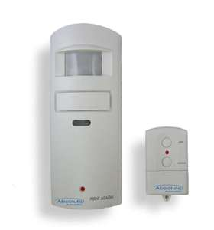










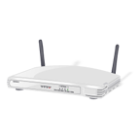
Can a cloud host high-assurance apps?
Motion sensor, fall-detector
Healthcare provider monitors large numbers of remote patients
Medication station tracks, dispenses pills
Integrated glucose monitor and Insulin pump receives instructions wirelessly
Cloud Infrastructure
Home healthcare application
CS5412 Spring 2015 (Cloud Computing: Birman)

Slide 36

Which matters more: fast response, or durability of the data being updated?
Mrs. Marsh has been dizzy. Her stomach is upset and she hasn’t been eating well, yet her blood sugars are high.
Let’s stop the oral diabetes medication and increase her insulin, but we’ll need to monitor closely for a week
Cloud Infrastructure
Patient Records DB
Tradeoffs determine speed and scalability!
CS5412 Spring 2015 (Cloud Computing: Birman)

Slide 37

What if we were doing online monitoring?
Update the monitoring and alarms criteria for Mrs. Marsh as follows…
Execution timeline for an individual first-tier replica
A B C D
Soft-state first-tier service
Response delay seen by end-user would also include Internet latencies
Send
Send
Local response delay
Send
Confirmed
flush
Durability matters more for patient records. But a monitoring system lives “in the moment” and mostly needs speed
CS5412 Spring 2015 (Cloud Computing: Birman)

Slide 38



Which matters more: consistency or fast response?
Air Traffic Controllers depend on consistent data
With a single server this isn’t hard to guarantee
ATC DB
Safe for US Air 221 to land?
CS5412 Spring 2015 (Cloud Computing: Birman)

Slide 39
Which matters more: consistency or fast response?
But suppose we replicate the server?
Designate one as “primary”
ATC DB
Backup
Safe for US Air 221 to land?

Slide 40
Which matters more: consistency or fast response?
Failure detection will be key to consistency
Otherwise could end up with two primaries!
ATC DB
ATC DB’
Safe for Air France 31 to take off?
Safe for US Air 221 to land?

Slide 41
Cloud computing: A world of tradeoffs!
Cloud computing systems
  Overcome failure by replicating services
  But have no standard way to decide which server is in charge for a given service
Easiest form of failure “detection” is by timeout
  But this might not be accurate: a network partitioning problem will look like a failure
    Maybe just some connections will fail
    And if the network then recovers, the old ATC service might not even know that we think it crashed!
CS5412 Spring 2015 (Cloud Computing: Birman)

Slide 42
Replication is central throughout
How to scale? Just add more replicas, balance load
Fault-tolerance? If something crashes but has replicas, the impact is localized and other servers can take over
Elasticity? Launch new replicas or shut some down
What makes replication hard are cases where we need to think about coordination, concurrency control...
If we don’t worry about such things, may even be able to reuse existing applications!
CS5412 Spring 2015 (Cloud Computing: Birman)

Slide 43
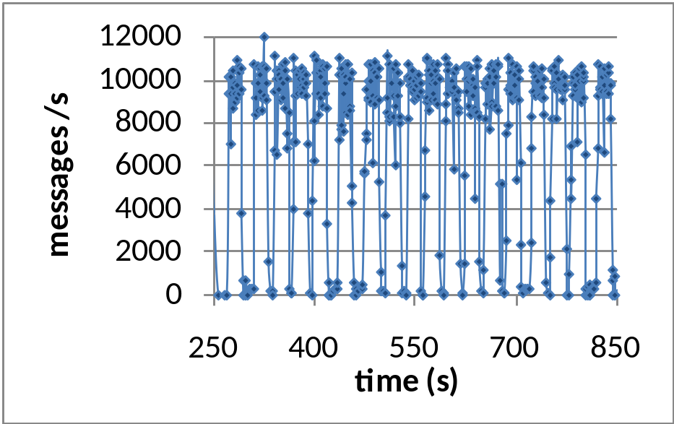

Thrashing: Illustrates that 10x concern
With small-scale replication, IPMC is a big win
But IPMC “storms” can occur in a data center with many replicas and heavy update rates
Wild load swings, heavy loss rates, thrashing
But it worked in the lab!

Slide 44
High assurance in the cloud
Today’s cloud is built with simple components and yet even so, exhibits problems like split brain behavior, thrashing, rolling failures, other issues
  Companies spending a fortune to eliminate such issues
  They can limit scalability
Tomorrow’s cloud thus poses a deep question
  Will it be limited to simple applications?
  Or can we migrate application like health care, transportation control, banking, etc to the cloud?
CS5412 Spring 2015 (Cloud Computing: Birman)

Slide 45
How will CS5412 approach such a complex set of problems?
We’ll take a step-by-step approach
First look at properties of the client platform
Next consider Internet and its evolution under pressure of the cloud (e.g. for controlled routing, higher availability, better security)
Finally focus on the data center and look at it tier by tier from the first tier inwards
CS5412 Spring 2015 (Cloud Computing: Birman)

Slide 46
At each level look at assurance issues
High assurance means different things in each layer
  A client depending on a browser worries about apps, personalization, connectivity, mobility, web-site spoofing, viruses, key-stroke logging, privacy...
  The network worries about efficient routing, BGP problem, DDoS attacks, authenticating
  The cloud worries about maintaining rapid response, balancing load, automating management, consistency, fault-handling, etc.
CS5412 Spring 2015 (Cloud Computing: Birman)

Slide 47
CS5412 Gets more technical as we go
For the first few weeks, we’ll be more engineering oriented, because the first kinds of issues are ones that center on how scaled-out systems are built
But then as we focus more on replicated processing and replicated data, we’ll bring more theory into the picture
Fault-tolerance will round off our investigation. We’ll explore many fault “models” but limit ourselves to ones seen in practice. We won’t do as much on security.
CS5412 Spring 2015 (Cloud Computing: Birman)

Slide 48
CS5412: Grades
Approximately 25 lectures, with [0-5] surprise quizzes to make sure you come to class.
  Must be in class on time to take quizzes. No makeups!
Homework assignments: Everyone does them, work as individuals, gain hands-on experience.
Prelim (in class) and final.
Course is curved to a B+/A-
CS5412 Spring 2015 (Cloud Computing: Birman)

Slide 49
CS5412: Organization
Professor Birman gives most lectures
Course roughly parallels his textbook
  Many assigned readings from textbook but they aren’t really required per-se; intended to help you understand the material
  Any quiz would focus on material covered in class because the goal of the quizzes is to ensure that you actually are coming to class
We have one full-time TA and three part-time TAs
Wednesday recitation: for homework help
CS5412 Spring 2015 (Cloud Computing: Birman)

Slide 50
CS5412: Projects
Used to be a part of this course but not in spring 2015 due to huge number of students, limited TA resources and (very frankly) some academic integrity issues in 2014
In 2015 projects will only be for students seeking to satisfy the MEng project requirement. You need permission and would sign up for CS5999 credit (3 credits).
CS5412 Spring 2015 (Cloud Computing: Birman)

Slide 51
Examples of projects from 2012
Integrate Isis² with Live Objects
Build services of the kind Amazon uses for system monitoring using Code Partitioning Gossip
Simulate and/or experiment on flow control for large scale replicated data sets, find best approach
Implement a realistic Air Traffic Control system with high assurance properties (or a health care system)
Explore best options for wide area file transfer
CS5412 Spring 2015 (Cloud Computing: Birman)

Slide 52
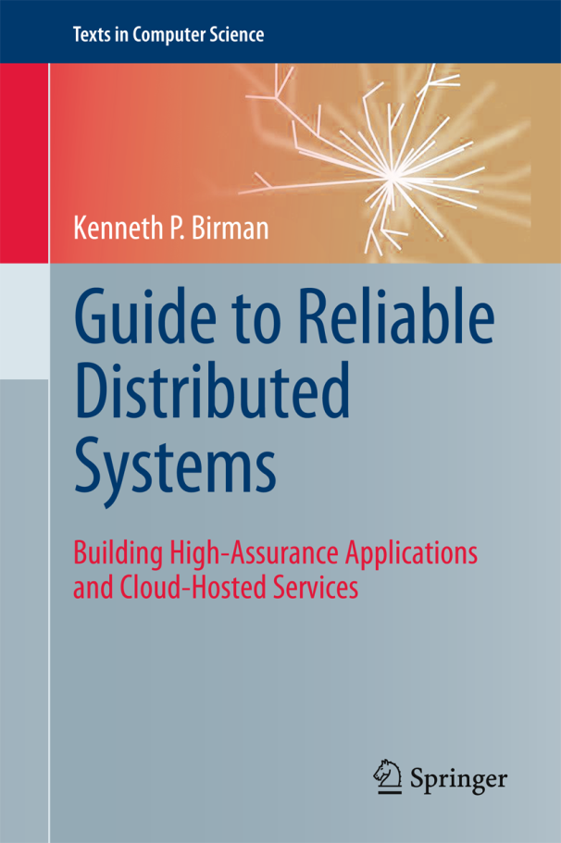
CS5412: Textbook
We’ll be using Ken’s textbook
  Written as a teaching tool
  Ken doesn’t earn royalties on it!
Available on reserve in library
if you prefer not to own a copy
Reading assignments will often be from the book but we may also assign a few published papers
CS5412 Spring 2015 (Cloud Computing: Birman)

Slide 53
Background assumed?
Solid understanding of computer architectures, operating systems, good programming skills including “threads” in Java, C++ or C#
Some basic appreciation of how networks work, how operating systems work, virtualization
Prior exposure to “distributed computing” not required or expected
CS5412 Spring 2015 (Cloud Computing: Birman)

